Slide 1
Discussing Climate Change with a Skeptical Iowa Public
Eugene S. Takle
Professor
Department of Agronomy
Department of Geological and Atmospheric Science
Director, Climate Science Program
Iowa State University
Ames, IA 50011
Sierra Club of Iowa
Iowa City, IA
1 October 2011

Slide 2
How Has Farming Changed? 1950-1970 1990-2010
Ground frozen all winter
Soil temps allow planting beginning ~May 10
Plant ~100-day corn
Plant density limited by soil moisture
Spring sub-soil moisture frequently below optimal amount
Draining pot holes is sufficient to prevent water-logged soils
Culverts under county roads prevent ponding in flat areas
Spraying for humidity-favoring diseases is rare
Occasional to frequent freeze-thaw
Soil temps allow planting beginning ~April 15
Plant ~110-day corn
Plant density determined by factors other than soil moisture
Spring soil moisture at field capacity
Tile grids on sloped surfaces are needed to prevent water-logged soils
Culverts under county roads too small to move water in flat areas
Spraying for humidity-favoring diseases is frequent

Slide 3
How Has Community Planning Changed? 1950-1970 1990-2010
Floods occur frequently in spring from snow melt
Floods almost never occur in summer
Street flooding is rare
Parks along streams and rivers are rarely impacted
4-inch home roof gutters are sufficient to prevent water accumulation around foundations
Water accumulates in basements occasionally
Mold occurs in basements occasionally, dehumidifiers are occasionally used
Spring floods are less frequent
Summer floods are frequent with high monetary loss
Street flooding is common
Parks along streams and rivers frequently need restoration
4-inch home roof gutters frequently are overtopped, leading to water accumulation around foundations
Water accumulation in basements is frequent
Mold in basements is frequent if dehumidifier not used

Slide 4
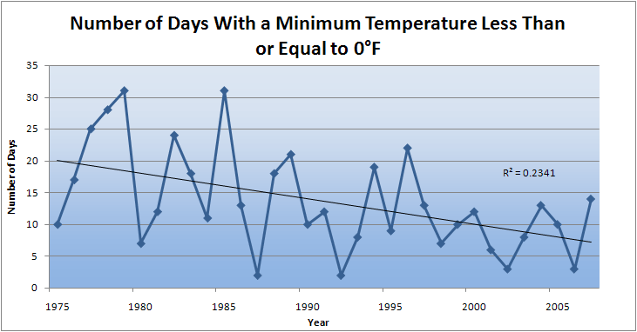
Des Moines Airport Data
Caution: Not corrected for urban heat island effects

Slide 7
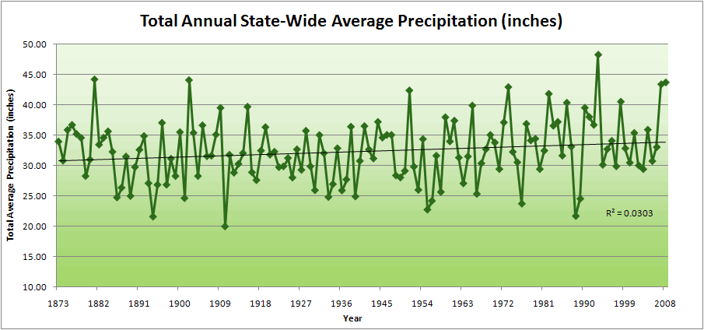
Iowa State-Wide Average Data

Slide 8
Iowa State-Wide Average Data
34.0”
10% increase
30.8”

Slide 9
Iowa State-Wide Average Data
Totals above 40”
8 years
2 years

Slide 10
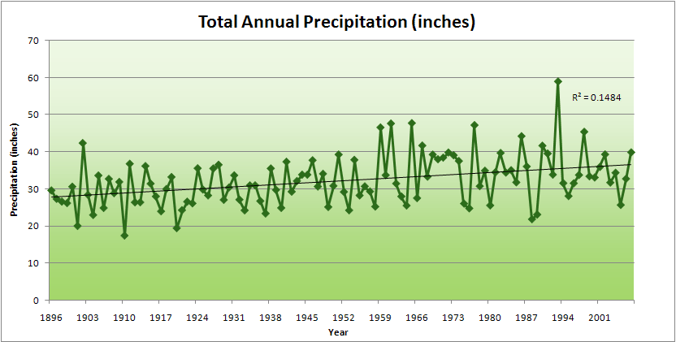
Cedar Rapids Data
Years with more than 40 inches
11
1
28.0”
32% increase
37.0”

Slide 11
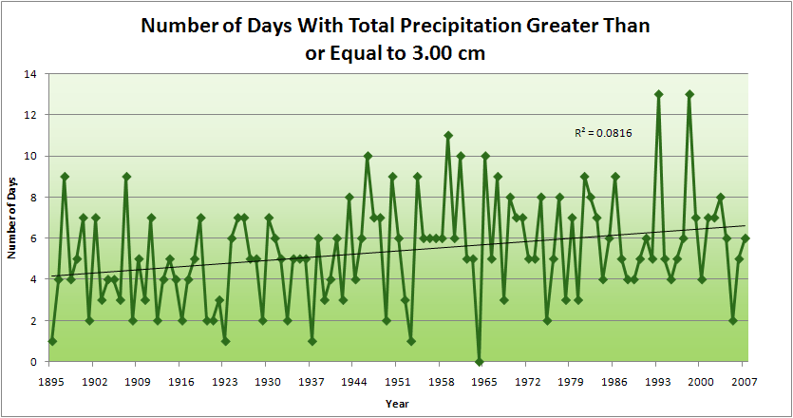
Cedar Rapids Data
1.25 inches
4.2 days
57% increase
6.6 days

Slide 12
Cedar Rapids Data
1.25 inches
Years having more than 8 days
13
2
4.2 days
57% increase
6.6 days

Slide 13
Years with more than 40 inches: 43% Increase
2010 so far

Slide 14
Years having more than 8 days
7
350% Increase
2
3.7
41% Increase
5.2

Slide 15
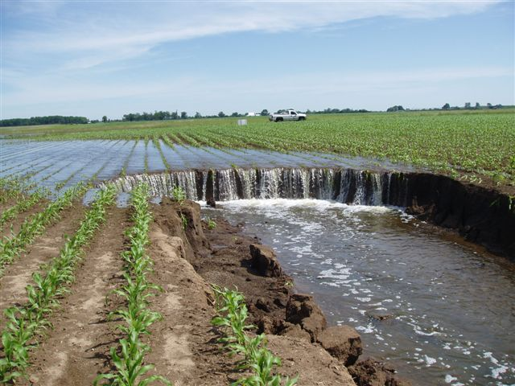
Photo courtesy of RM Cruse

Slide 16
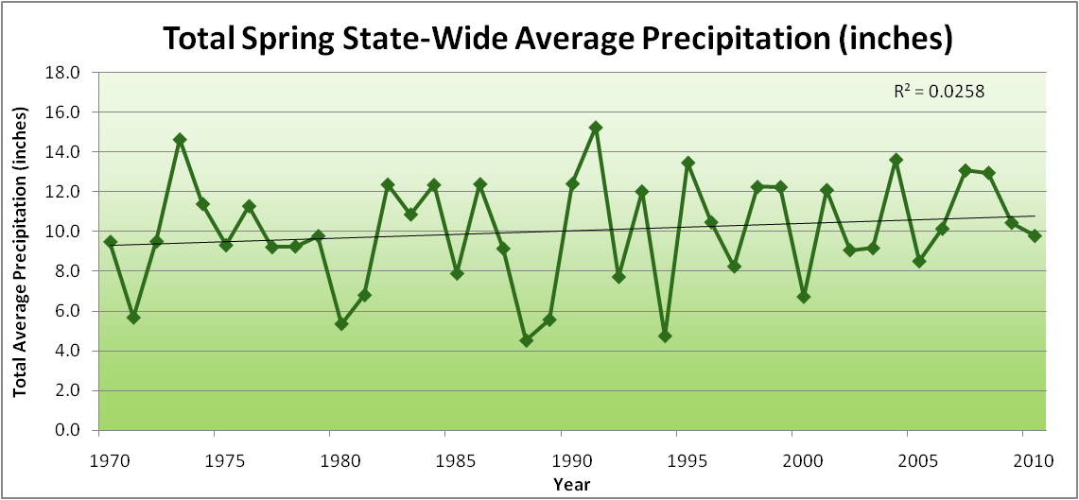
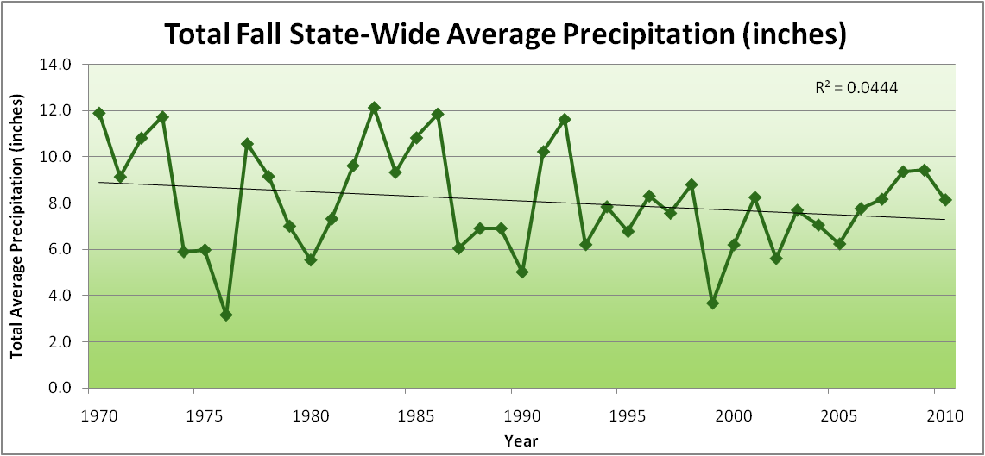
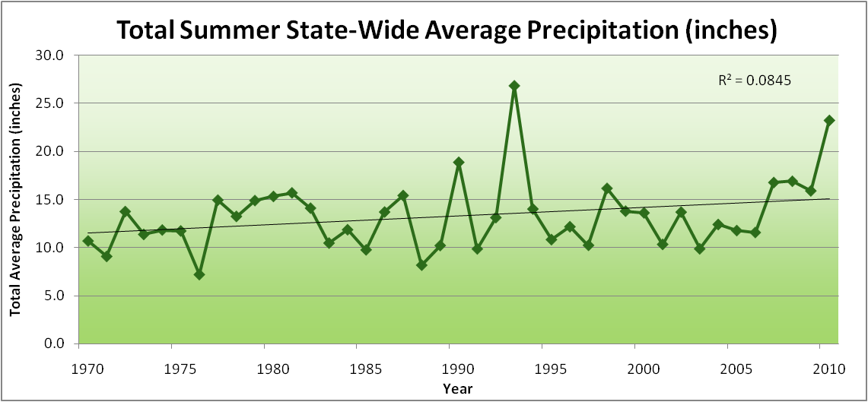
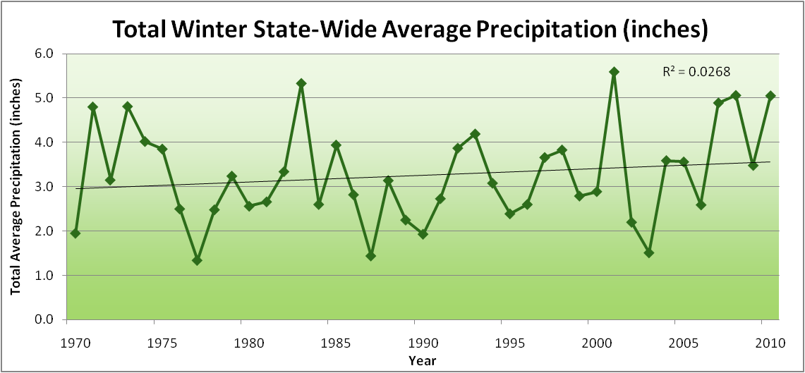
Amplification of the Seasonality of Precipitation
Spring
Fall
Summer
Winter

Slide 17
Amplification of the Seasonality of Precipitation
Spring
Fall
Summer
Winter

Slide 18
Amplification of the Seasonality of Precipitation
Spring
Fall
21.2 => 25.3 inches (22% increase)
12.1 => 10.5 inches (13% decrease)
Summer
Winter

Slide 19
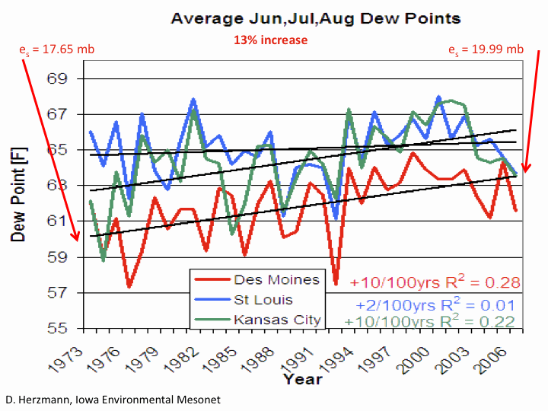

Slide 20
Visioning Future Climate Change for Iowa

Slide 21
Visioning Future Climate Change for Iowa
You are here

Slide 22
Visioning Future Climate Change for Iowa
You are here
Today

Slide 23
Visioning Future Climate Change for Iowa
You are here
Today
Past

Slide 24
Visioning Future Climate Change for Iowa
You are here
Today
Past
Future

Slide 25
Visioning Future Climate Change for Iowa
You are here
?
Today
Past
Future

Slide 26
You be the scientist: For which hypothesis of the future can you find the most evidence?
?
Some Climate Variable (temp, precip, humid)
Today
Past
Future

Slide 27
You be the scientist: For which hypothesis of the future can you find the most evidence?
Some Climate Variable (temp, precip, humid)
Measured past
Today
Past
Future

Slide 28
You be the scientist: For which hypothesis of the future can you find the most evidence?
Some Climate Variable (temp, precip, humid)
Future will return to something in the past
Measured past
Today
Past
Future

Slide 29
You be the scientist: For which hypothesis of the future can you find the most evidence?
Future will be like average of the past
Some Climate Variable (temp, precip, humid)
Future will return to something in the past
Measured past
Today
Past
Future

Slide 30
You be the scientist: For which hypothesis of the future can you find the most evidence?
Future will be like today
Future will be like average of the past
Some Climate Variable (temp, precip, humid)
Future will return to something in the past
Measured past
Today
Past
Future

Slide 31
You be the scientist: For which hypothesis of the future can you find the most evidence?
Current trend will continue
Future will be like today
Future will be like average of the past
Some Climate Variable (temp, precip, humid)
Future will return to something in the past
Measured past
Today
Past
Future

Slide 32
You be the scientist: For which hypothesis of the future can you find the most evidence?
What does the best available science have to say?
Current trend will continue
Future will be like today
Future will be like average of the past
Some Climate Variable (temp, precip, humid)
Future will return to something in the past
Measured past
Today
Past
Future

Slide 33
You be the scientist: For which hypothesis of the future can you find the most evidence?
Based on climate models, climate scientists overwhelmingly agree that the future will be more extreme than today
Current trend will continue
Future will be like today
Future will be like average of the past
Some Climate Variable (temp, precip, humid)
Future will return to something in the past
Measured past
Today
Past
Future

Slide 34
You be the scientist: For which hypothesis of the future can you find the most evidence?
Future will be more extreme than today
Current trend will continue
Future will be like today
Future will be like average of the past
Some Climate Variable (temp, precip, humid)
Future will return to something in the past
Measured past
Today
Past
Future

Slide 35
You be the scientist: For which hypothesis of the future can you find the most evidence?
Some Climate Variable (temp, precip, humid)
Measured past
Today
Past
Future

Slide 36
My Opinion
A Prudent View of the Future
Some Climate Variable (temp, precip, humid)
Measured past
Today
Past
Future

Slide 37
Future Challenges to Adaptation in the US Midwest (near term):
Wetter spring and early summer:
Continued challenges to early field work
More soil compaction
Delayed planting
More frequent and higher-intensity extreme rain events:
Water-logged soils
Lack of oxygen to roots
More ponding (rural roads are becoming levees)
Additional installation of subsurface tile drainage is inundating downstream urban areas
Loss of nitrogen
Higher daily average temperatures (due to higher night-time temperatures):
Differential acceleration of reproductive processes: pollination failure
During grain-filling periods leads to higher nighttime respiration and reduced grain weight
Loss of soil carbon
Increased humidity:
More pressure from pests and pathogens
Multiple stressors

Slide 38
Future Challenges to Adaptation in the US Midwest (long-term, occasional short-term):
Drought pattern from the west or south occasionally spills into Midwest:
Underlying warming of the last 40 years caused by rise in CO₂ that has been buffered by high evaporative and transpiration cooling is unmasked
High plant populations not sustainable on reduced moisture
Prairie fires
Wind erosion of soils
Overwintering of pests and pathogens formerly not able to survive extreme cold temperatures

Slide 39
Climate trends of the recent past have low statistical significance. Nevertheless, they have forced significant adaptation for Iowa farmers and communities:

Slide 40
Climate trends of the recent past have low statistical significance. Nevertheless, they have forced significant adaptation for Iowa farmers and communities:
Even climate trends of low statistical significance can have impacts of high significance to Iowa agriculture and communities

Slide 41
Sustaining agricultural production without depleting natural resources will become increasingly difficult with increasing levels of climate change

Slide 42
Iowa Scientists are Engaged in Major Forthcoming National and International Reports on Climate Change
Bill Gutowski, ISU: Lead Author, Chapter 12 (Long-term Climate Change: Projections, Commitments and Irreversibility) of the Working Group 1 report for the Fifth Assessment Report of the Intergovernmental Panel on Climate Change
Jerry Hatfield, ISU/ARS: Co-Leader, Agriculture Sector Report and Co-Leader of the Midwest Regional Report of the 2013 National Climate Assessment (NCA) Report
Gene Takle, ISU: Convening Lead Author, Agriculture Chapter, 2013 National Climate Assessment (NCA) report

Slide 43
For More Information
Contact me directly:
gstakle@iastate.edu
Current research on regional climate and climate change is being conducted at Iowa State University under the Regional Climate Modeling Laboratory
http://rcmlab.agron.iastate.edu/
North American Regional Climate Change Assessment Program
http://www.narccap.ucar.edu/
Climate Science Program website:
http://climate.engineering.iastate.edu/
Or just Google Eugene Takle

